Slide 1
WELCOME Class: B.Com – Part-2 Subject: Business Regulatory Framework TOPIC: Proposal or offer – Meaning, essential elements, classification and rules as to Proposal or offer
Prepared By
Dr. SHAHID IQBAL
Guest Faculty,
Marwari College, Darbhanga,
Mobile No. and Whatsup No. : 7004160257
Email ID: shahidlnmu@gmail.com

Slide 2
Proposal or offer: -
According to Section 2(e) of the Indian Contract Act, ” When one person signifies to another his willingness to do job or to abstain from doing anything with a view to obtaining the assent of the other to such act or abstinence he is said to
make a proposal.”
Offer is one of the essential elements of a contract. The person making the offer or proposal is called the offeror, proposer or promisor and the person to whom the proposal is made is called ‘the propose’ or offeree.
Example:
X desire to sell his Car to Y for Rs. 3,00,000 _ it does not constitute offer, because X has merely expressed his desire. On the other hand if X asks Y would you buy my Car for Rs.3,00,000, this makes an offer, and here X is the offeror.

Slide 3
Elements/Main features of a Proposal of Offer:
Existence of two parties
For a valid offer, there must be two parties. A person cannot make an offer to himself.
2. Communication
The offer must be communicated to the offence. If it is never communicated to the offence, it cannot be accepted and no valid contract comes into existence.
3. Willingness
The offer must show willingness of the offer or mere telling or sharing a plan is not an offer.

Slide 4
4. Intention of Obtaining Assent: The offer must be made with a view to obtain the assent of the offeree. The offer made out of a prank or as a joke is not valid offer, and therefore if accepted, it can never make the valid contract.
5. May be positive or Negative: The offer may involve doing something or not doing something-Section 2(o).The offer to do something is a positive offer or not to do something is a negative offer.
6. Offer may be conditional: - An offer can be made subject to a condition. It can be accepted only subject to those conditions. If the condition is not accepted, the conditional
offer lapses.
7. Invitation to an offer is not an offer:- Offer is different from invitation to an offer. Quotations, catalogues of goods, advertisement for tender etc are not actual offer. They are mere invitation to offer.

Slide 5
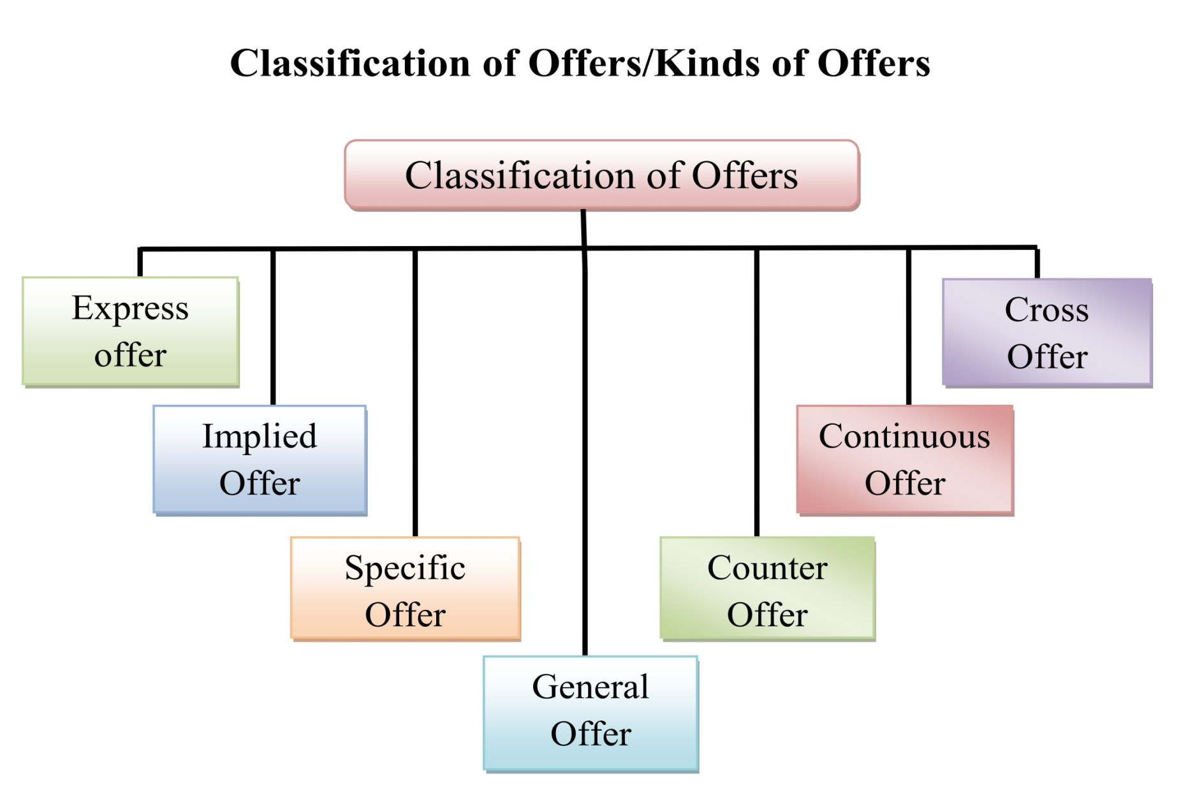

Slide 6
Classification of Proposal or Offer:
1. Specific offer: - When an offer is made to a specific person or class of persons, such offer is known as specific offer. The specific offer can be accepted only by that particular person or organization.
2. General offer: It is an offer which is made to a group of people or public at large. Such
offer can be accepted by any member of that group.
3. Cross offer: - When two parties exchange identical offers with each other, in ignorance of
each other’s offer, the offers are cross offer.
4. Counter offer: Incomplete and conditional acceptance of an offer is known as counter offer. In other words, when an original offer is rejected and a new offer is made, it is known as counter offer.
5. Standing offer (Tender):- An offer for a continuous supply of a certain article at a certain rate over a definite period is called a standing offer.

Slide 7
Legal Rules as to Proposal or Offer
1. Offer Must be definite: Unambiguous and certain They must be vague or indefinite. If the terms are vague, it is not capable of being accepted as the vagueness would not create any contractual relationship.
2. Offer should not bind the other party to reply: The offer should not bind the other party to reply. In the same way, if the offer should not contain terms, non- compliance of which may be assumed as acceptance.
3. Offer must be made to create legal relationship: While making the offer, the aim of the offerer should be to primarily create a legal obligation. An offer that creates only social or moral obligations does not constitute a valid agreement or contract.
4. The offer may be general or specific: An offer is called specific when it is made to an individual or a group of individuals. In case of a specific offer, only the person or group of persons to whom the offer is made can accept or reject the offer.

Slide 8
5. The offer may be express or implied: An offer does not necessarily need to be express it can also be implied. According to Section 9,a specific offer can be made in words-written or oral.
6. The offer should be a request and not an order: The person making the offer has the right to set conditions to the acceptance of the offer but he does not have any right to set conditions to the non-acceptance
of the offer.
7. The offer must be for a possible act: Man can do only what is possible and the laws accepts that. An offer or a proposal to do impossible is devoid of practicality or meaning. To make an offer which is humanly impossible is not recognized by law and as such there can be no compliance.
8. The offer must be communicated: An offer to be complete, must be communicated to the person to whom it is made so that he can accept or not accept the offer. Unless the offer is communicated by the offerer (or by his agent) to the offeree, there can be no acceptance of the offer and as such, no agreement can be reached.

Slide 9
Thank You

